Slide 1
Web Development Project
Ekaterina Dul 2102930

Slide 2
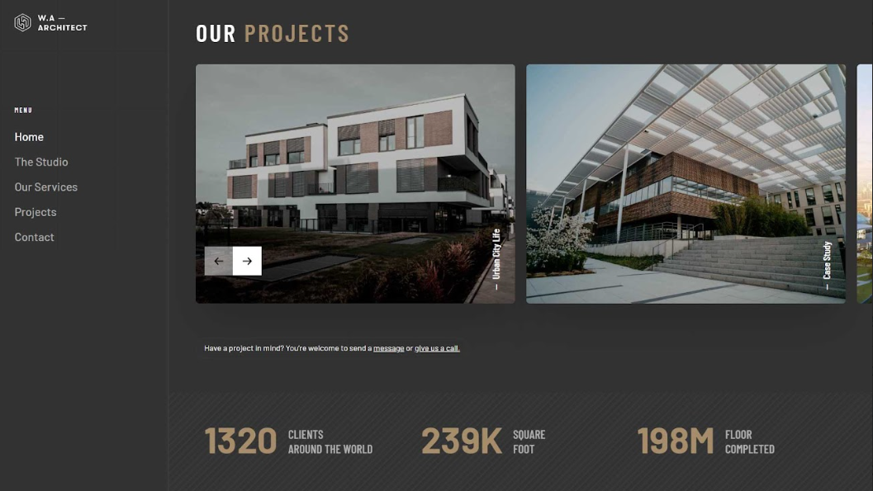
Initial Design

Slide 3
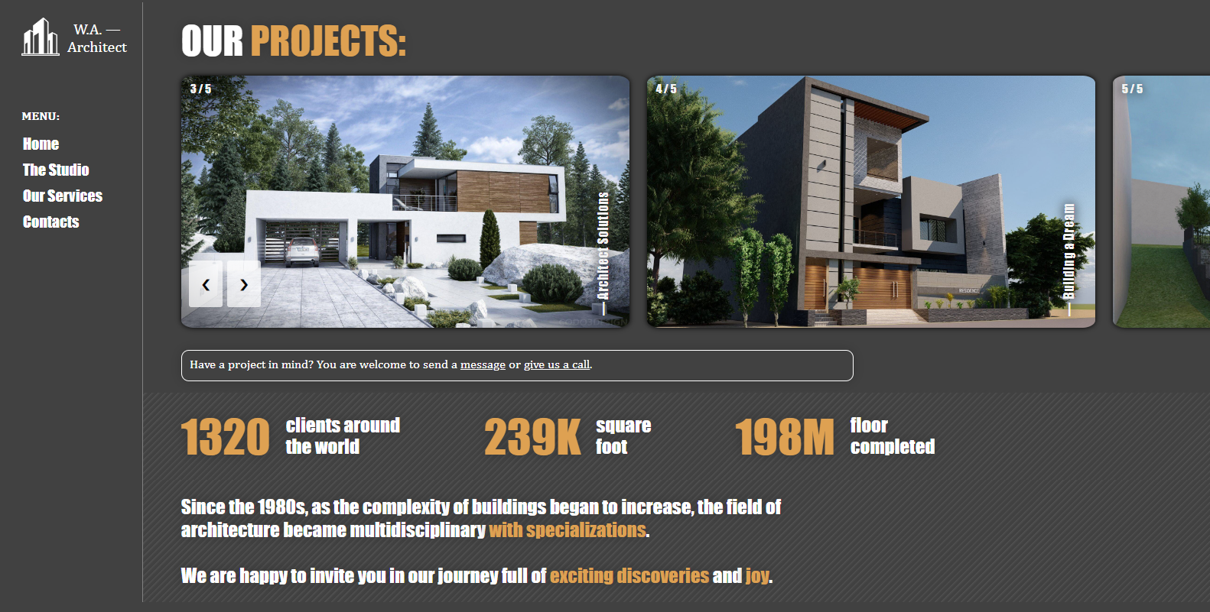
Home Page: Main Result

Slide 4
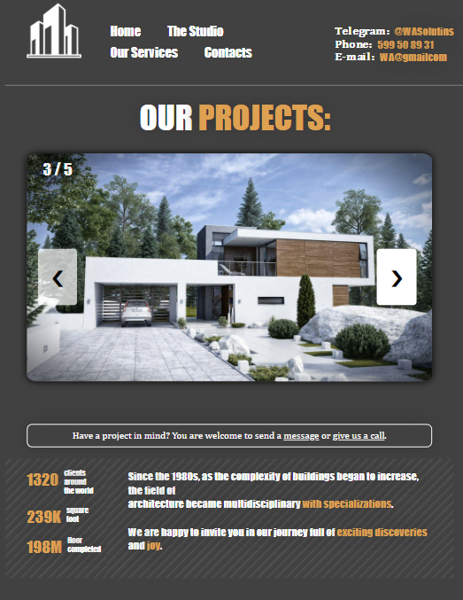
Home Page: Mobile Version
Hiding two following pictures in slideshow and unnecessary vertical pictures captions.
Left & right buttons are displayed on the corresponding borders.
Fonts and pictures are displayed smaller than for medium & large devices.
Was done through media query, since changes in layout get too complicated for Bootstrap.

Slide 5
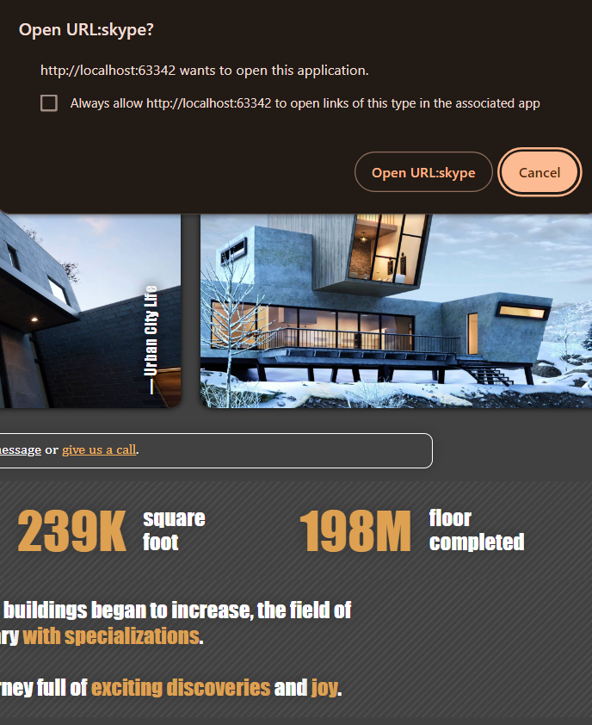
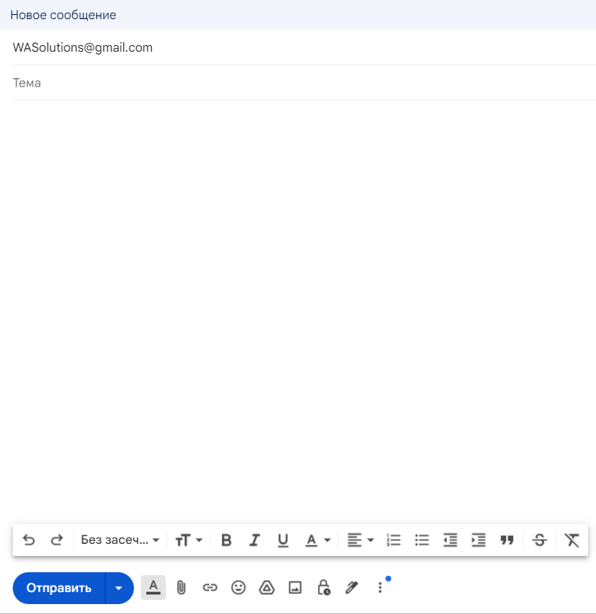
Main Features of Home Page : Contact Links
Small note in article contains two contact links to e-mail and skype accounts of the organization.
Were done using “href” attribute.
E-mail link was implemented by: href = “ https://mail.google.com/mail/?view=cm&fs=1&tf=1&to=WASolutions@gmail.com0”
Skype link was implemented by: href =“ skype:live:WASolutionsSkype?call”

Slide 6
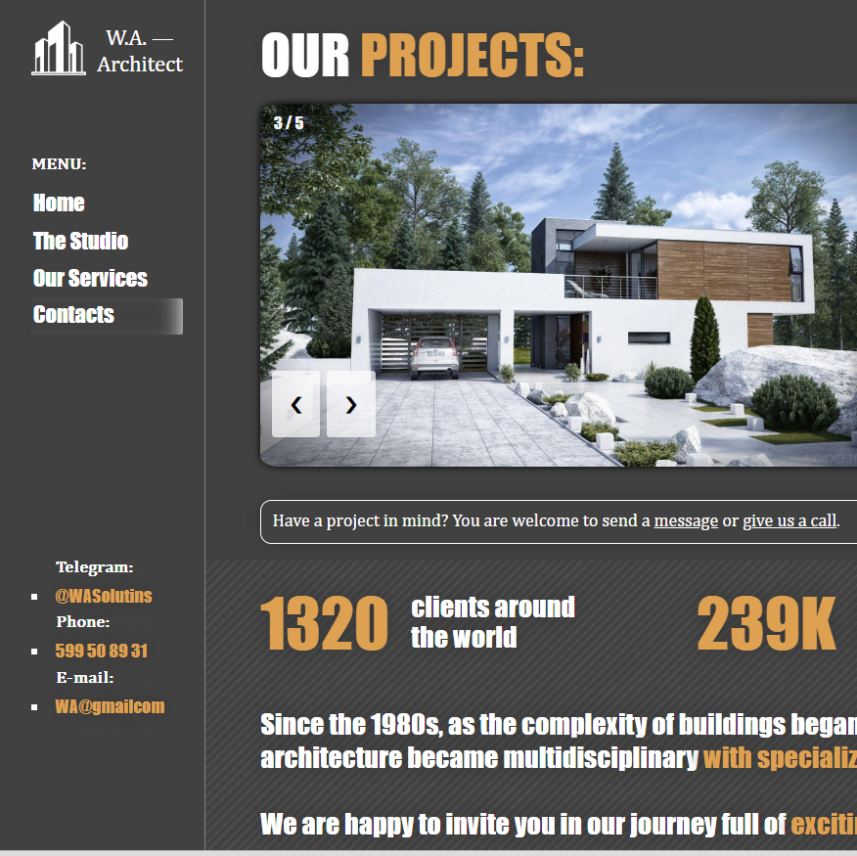
Main Features of Home Page : Contact Section
While clicking on “Contacts” item, section with necessary contacts and links will be displayed in left-bottom corner.
In mobile version “Contacts” section is displayed in the right-upper corner and changes list-style from “square” to “none”.

Slide 7
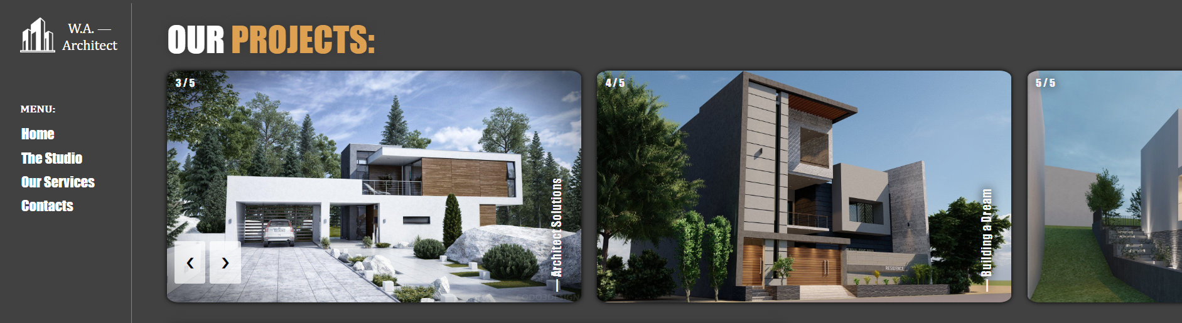
Main Features of Home Page : Slideshow
Left / Right buttons move gallery pictures on exact one position. Pictures are displayed as a cycle.
Exactly 5 pictures with numeration and additional vertical capture with appropriate transition effect.
Partial pictures (3rd in a row) were implemented as copies of full ones with special class = “myPartialSlides”.

Slide 8
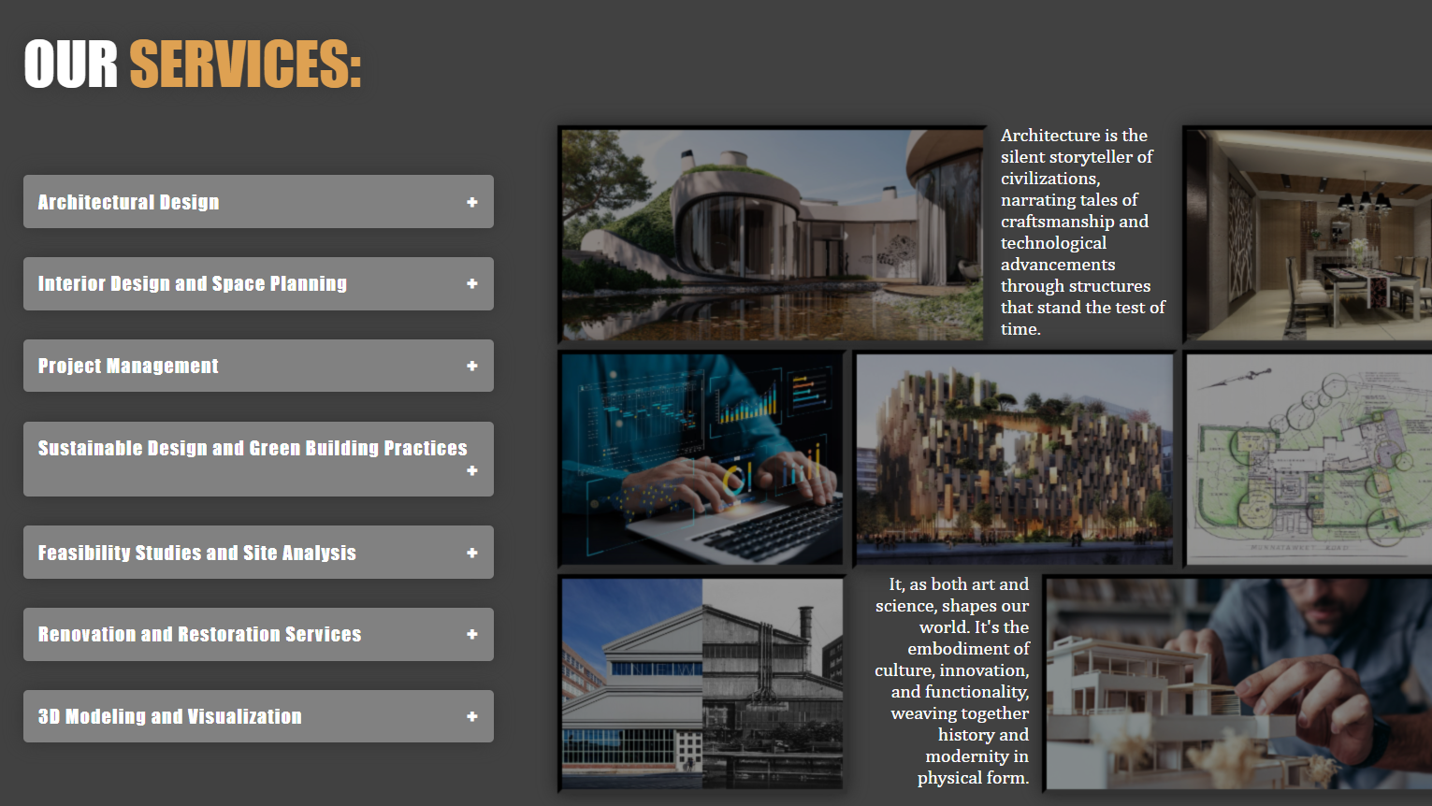
Services Page: Main Result

Slide 9
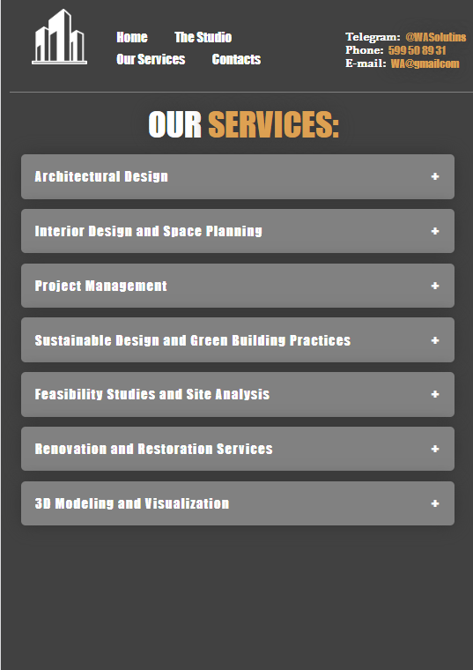
Services Page: Mobile Version
Hiding pictures gallery and other small unnecessary elements.
Horizontal heading menu and dynamic elements allocating through flex & inline-block parameters.
Fonts and pictures are displayed smaller than for medium & large devices.
Was done through media query.

Slide 10

Main Features of Service Page : Accordion
Accordion with showing / hiding corresponding paragraphs on click.
Automatically changing “+” and “-” on titles.
Actions are processed through JS event listeners and this.nextElementSibling.

Slide 11
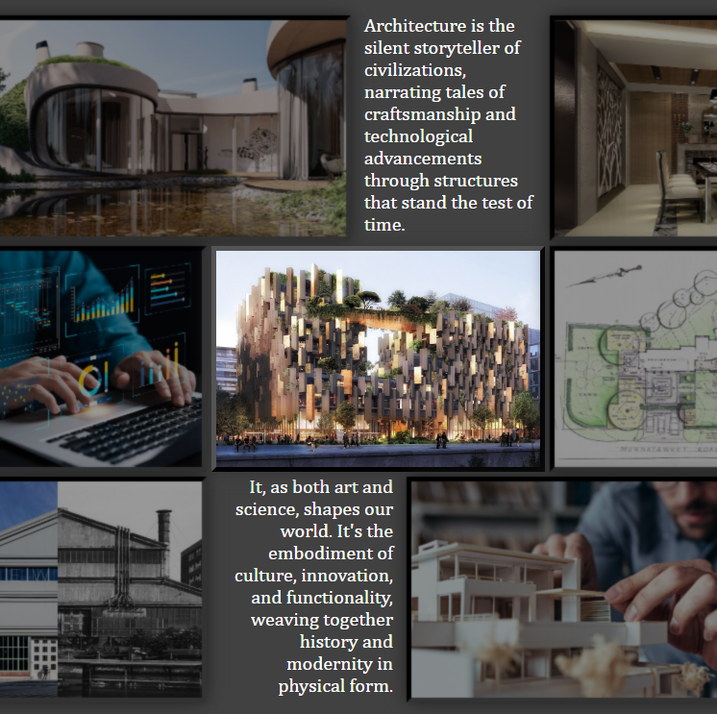
Main Features of Service Page : Gallery
Grid layout through grid-template-element attribute.
Initially pictures are blurred and have lower brightness, but on hover it shows initial picture.
All pictures have dynamic border styling and transition on hover action.

Slide 12
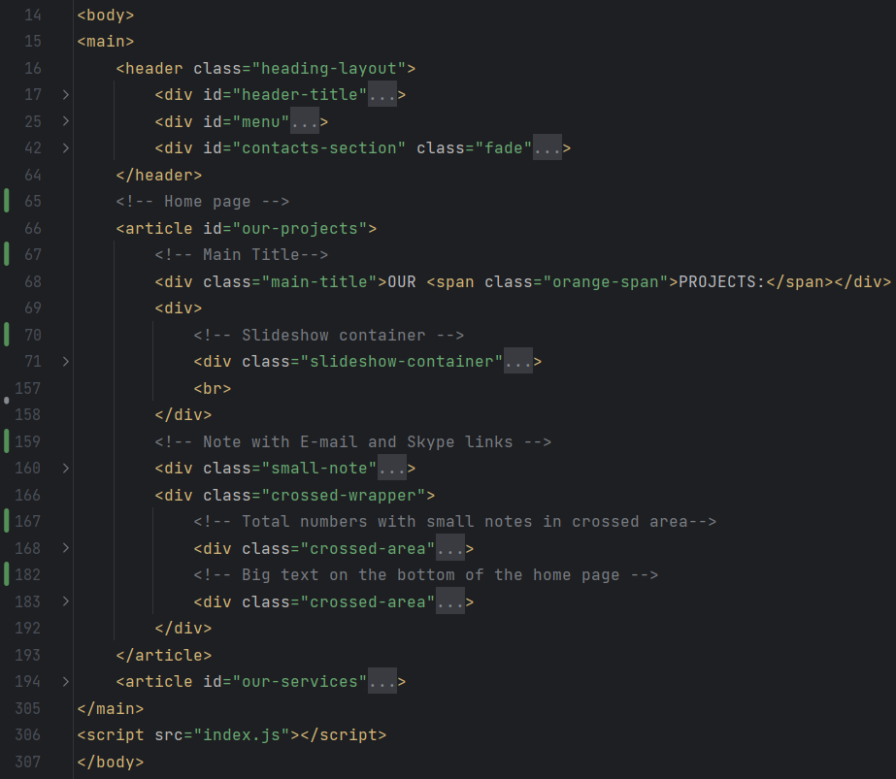
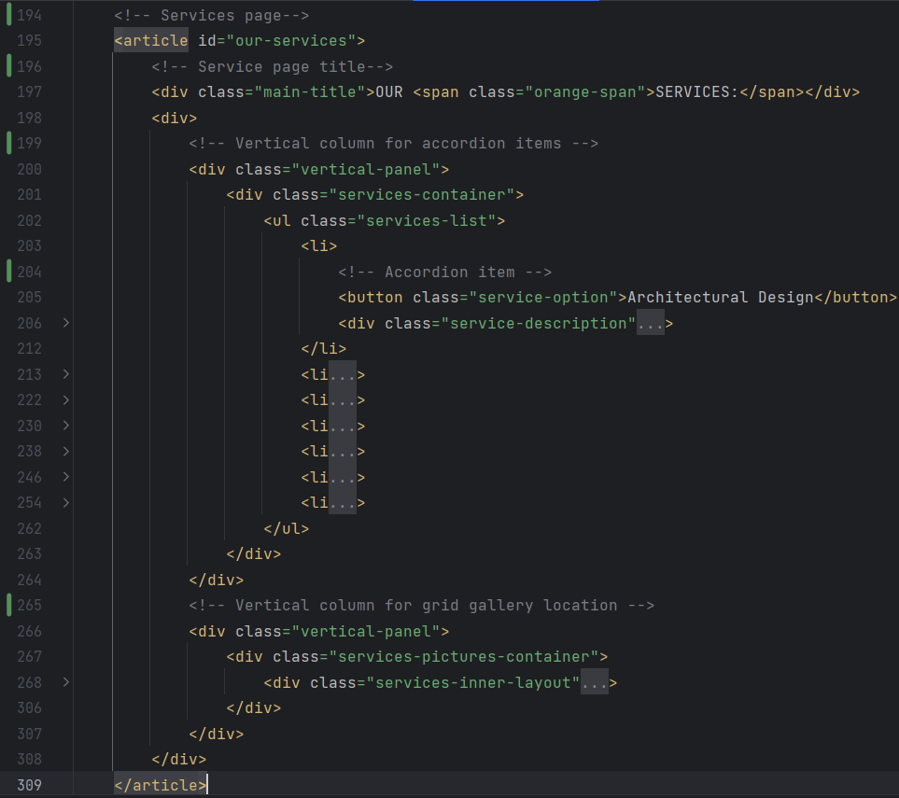
General Project Structure: HTML

Slide 13
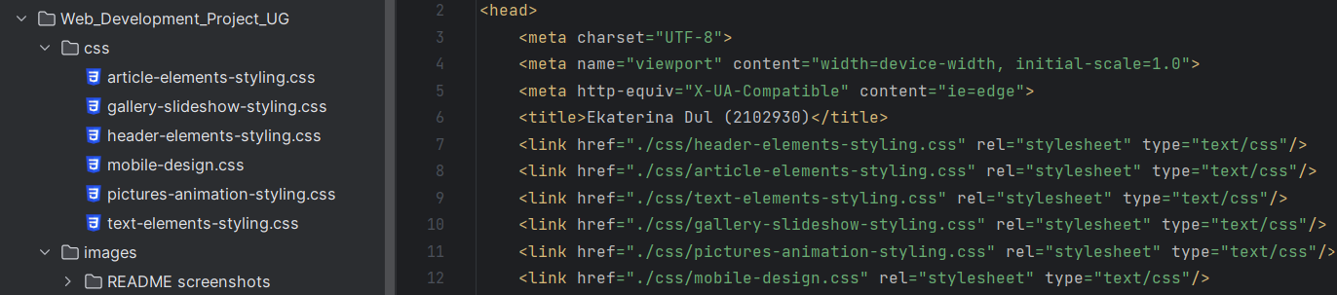
General Project Structure: CSS
For development purposes all CSS styling was split in separate CSS files with self-describing names.
However, they could be merged into one huge CSS file.
For CSS styling were used 711 lines of code.

Slide 14
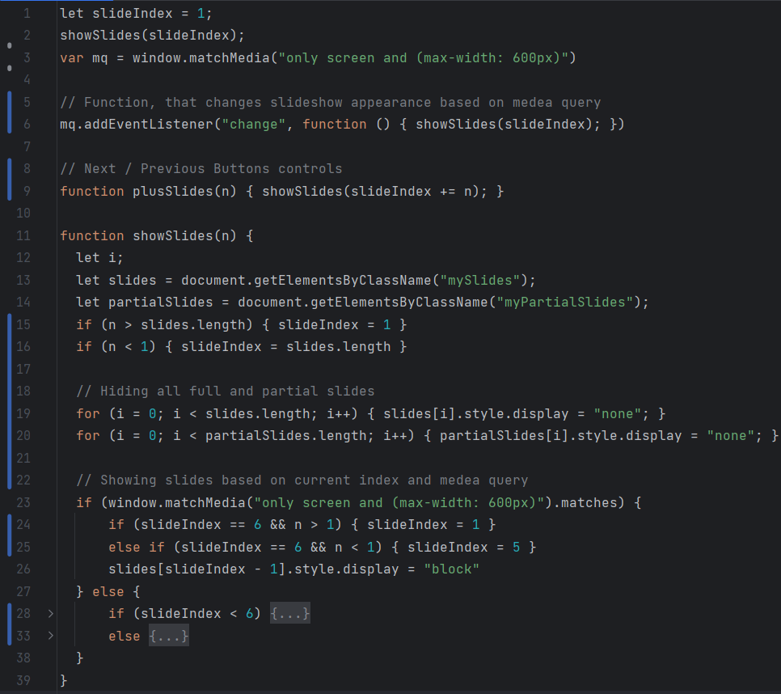
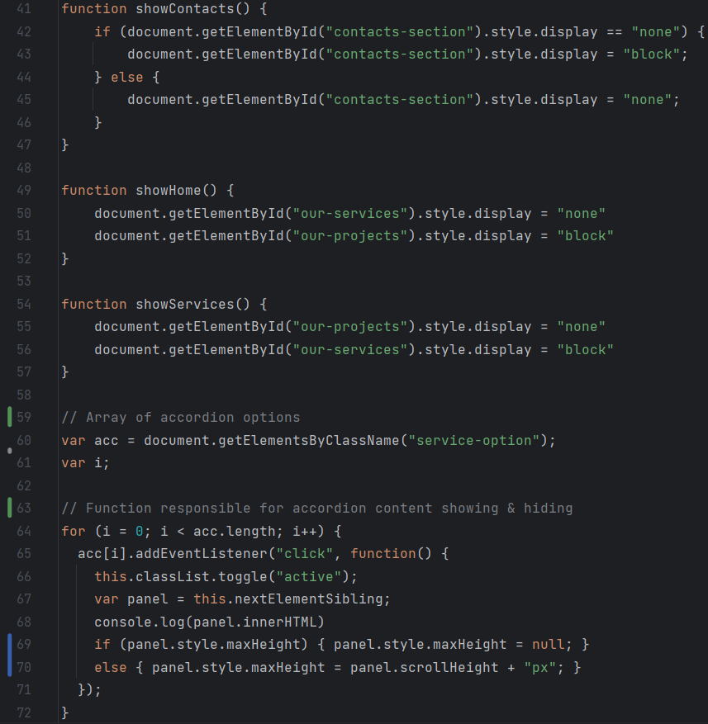
General Project Structure: Java Script

